Slide 1
Finance Credit Team Sprint Update 3
October 16th, 2023
Lucas | Kendall | lakendal@mtu.edu
Trent | Magers | tfmagers@mtu.edu
Emily | Wood | Ewood@mtu.edu
Reyn | White | walterw@mtu.edu
Irene | Trierweiler | Iltrierw@mtu.edu
Joseph | Williams | jokwilli@mtu.edu
Atharva | Joshi | atharvaj@mtu.edu
John | Mware | jmware@mtu.edu

Slide 2
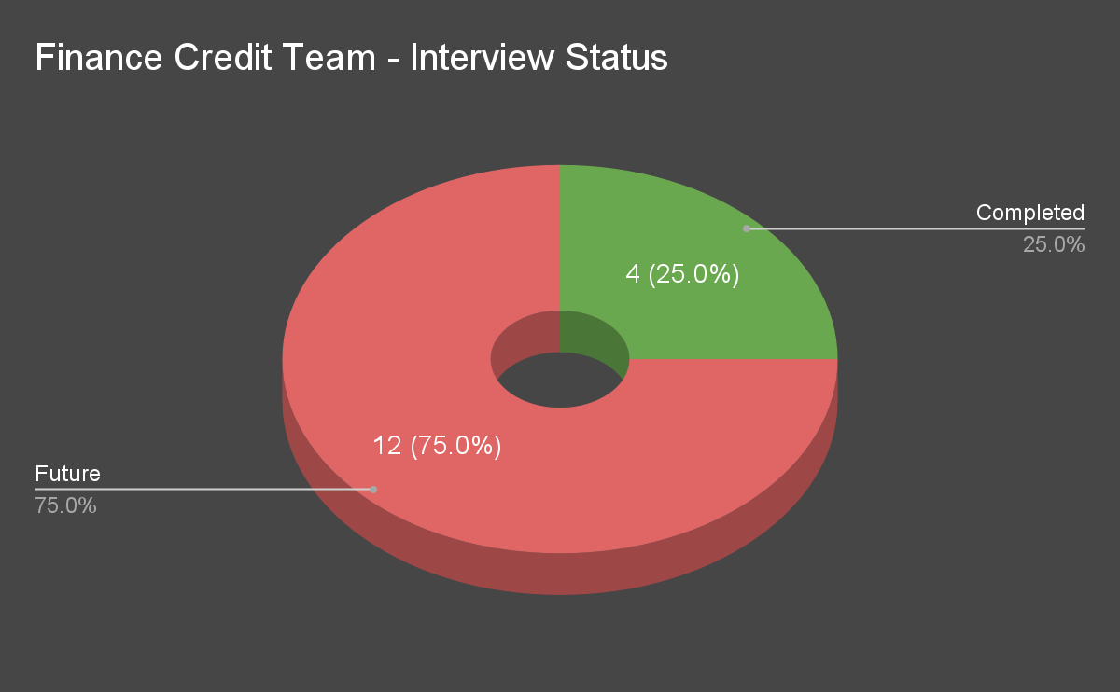
Interviews Status

Slide 3
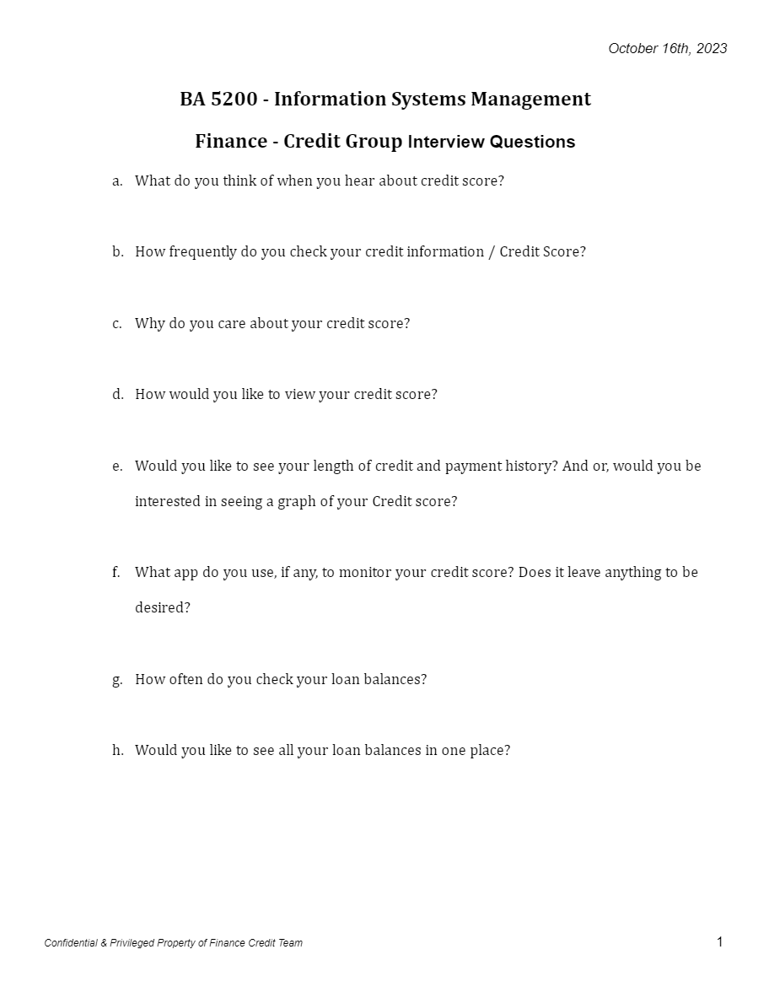
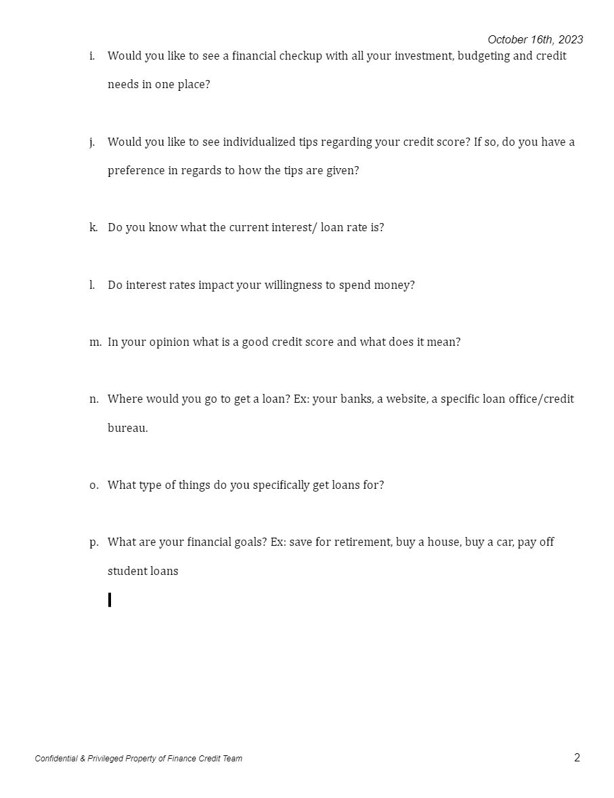
Interviews Question Amendments

Slide 4
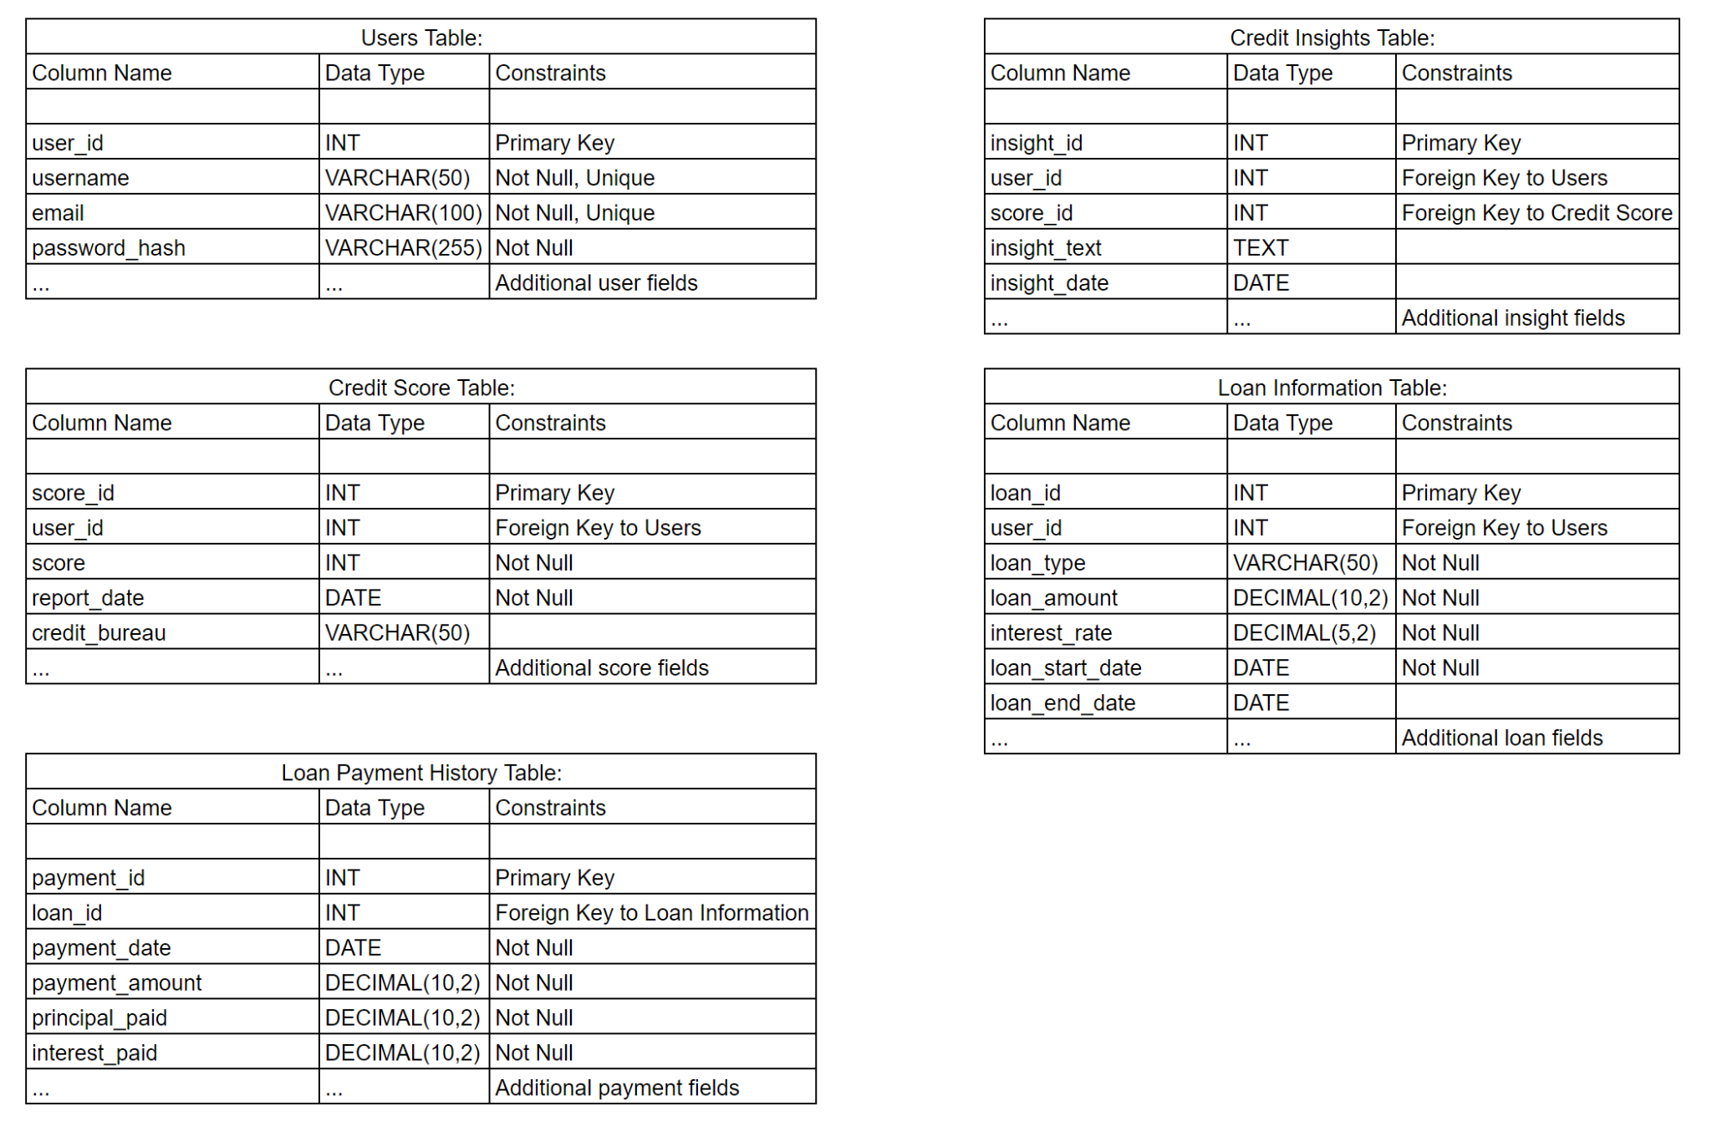
Database Schema

Slide 5

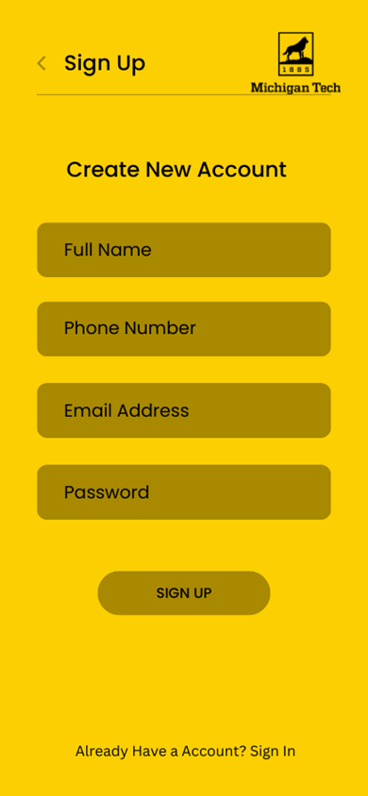
Application Development
Credit to Nutrition Teams - Application Standard. We recommend and advise other teams to utilize this application platform layout.
Our team will be moving forward utilizing the proposed layout.

Slide 6
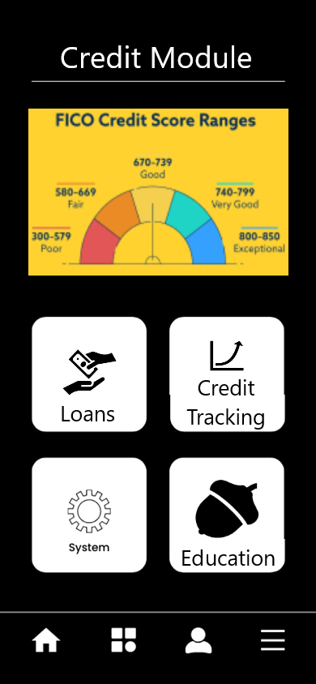
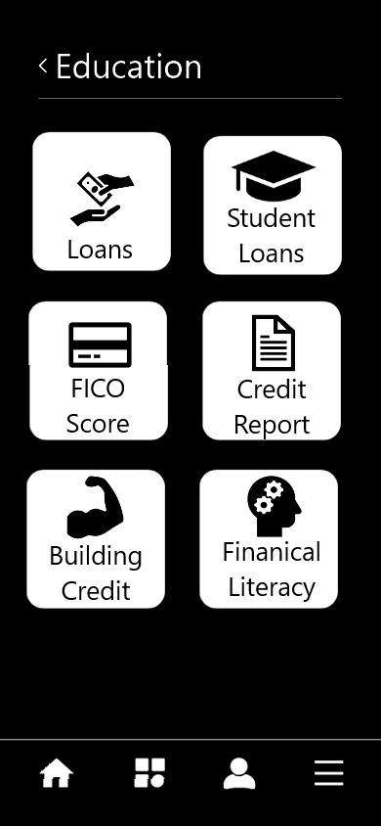

Application Development

Slide 7
Steps Moving Forward
Continuing Development of User Interface
Loans Tracking.
Credit Tracking.
Education/Tips & Tricks Module.
Linking With Financial Literacy.
Interviews
Driving additional 4 interviews with new questions
Remaining 8 interviews for future development/feedback.
Continuous Improvement on Trello project tracking.

